Slide 1

Home Water Reservoir Automation System
Group No 9
Team Members
Ali Hamza Malik 291480
Ali Aqdas 285050
Muhammad Ibrahim 291898
Muneeb Elahi Malik 288106

Slide 2


Introduction
Many houses need a system for automating the Motor On/Off signal whenever the Overhead reservoir falls below a certain level
Our System provides a Cheap and Easy to Install solution for automating this process

Slide 3
Project Scope
Can be used in houses to minimize loss of water
Automate Motor On/Off cycles depending on Water Levels of Overhead and Ground Reservoir
Indicators for Flow rate
IR sensors and Alarm system for Leakage indicator and Empty Reservoir
The System is based around Ultrasonic Sensor which makes it easy to install
The system can be easily modified to fit large housing complex

Slide 4
Home Water Reservoir Automation System
Project Blocks :
Water Level Calculator
Flowrate Monitor
Control Logic
Display Unit

Slide 5
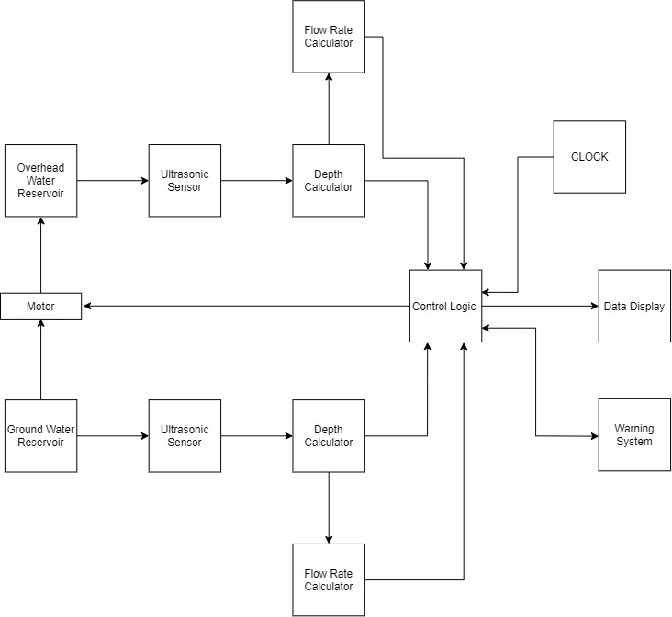
Block Diagram

Slide 6

Water Level Calculator
The water level detector detects the depth of water inside a water tank via ultrasonic sensor and gives a 5-bit output indicating the depth of the water
The water level is displayed to the user with the help of LED display

Slide 7
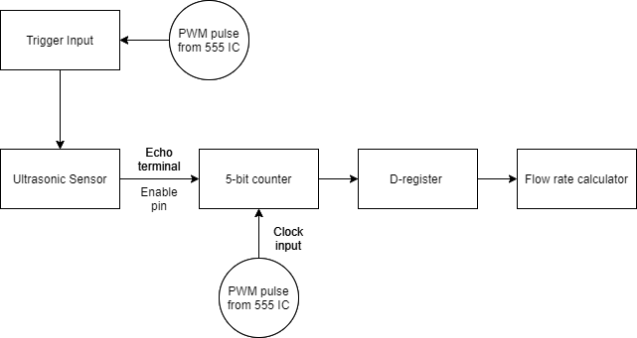
Block Diagram

Slide 8
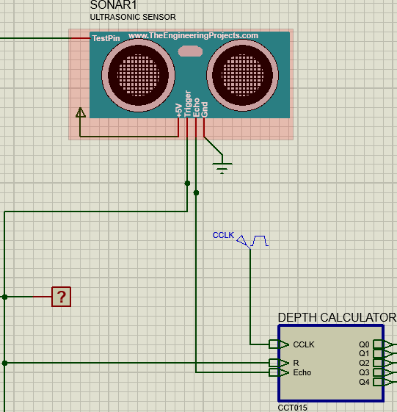
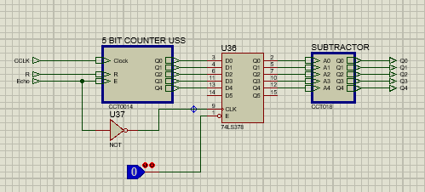
Simulation

Slide 9
Flowrate Monitor
The basic function of flow rate monitor is to check the nature of flow in the reservoir as well as the relative measurement of the flow rate
It gets the input from the depth calculator synchronously under the influence of clock pulse, stores the input and compares it with the next coming input

Slide 10
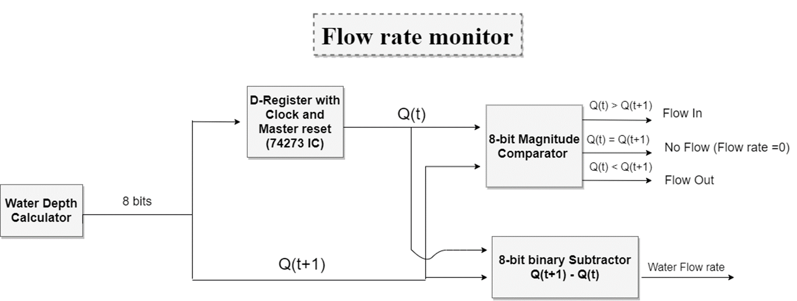
Block Diagram

Slide 11
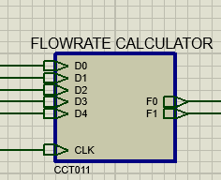
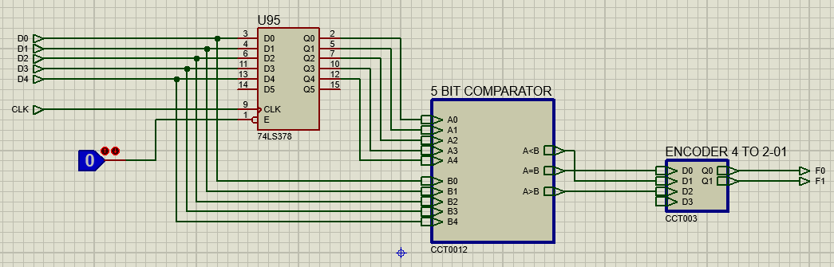
Simulation

Slide 12
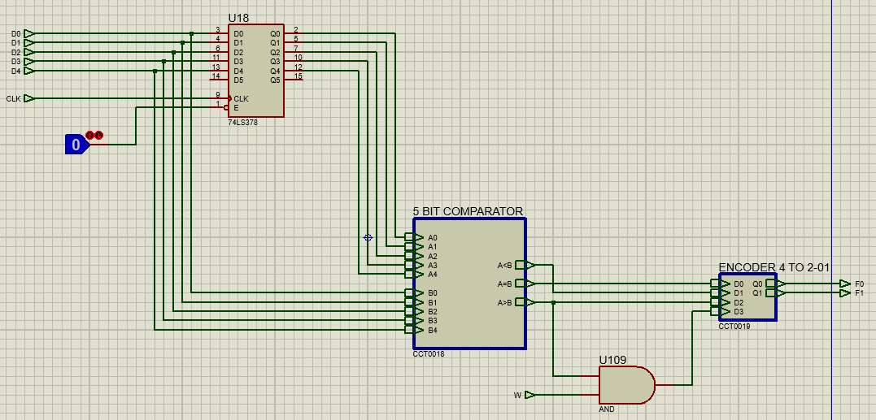
Simulation

Slide 13
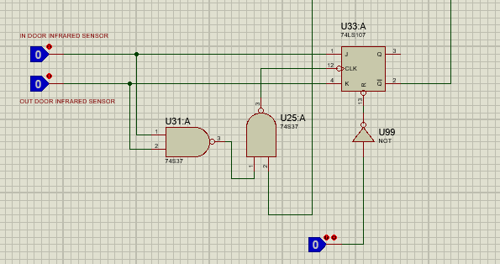
Simulation

Slide 14
Control Logic
The purpose of Control Logic unit is to take inputs from Depth Calculator, Flowrate Monitor and IR sensors
To generate signals for Display unit
Whether Motor is turned On or Off
Signals for LEDs for Flowrates
Sensitivity Control for various dimensions of Water Reservoir

Slide 15
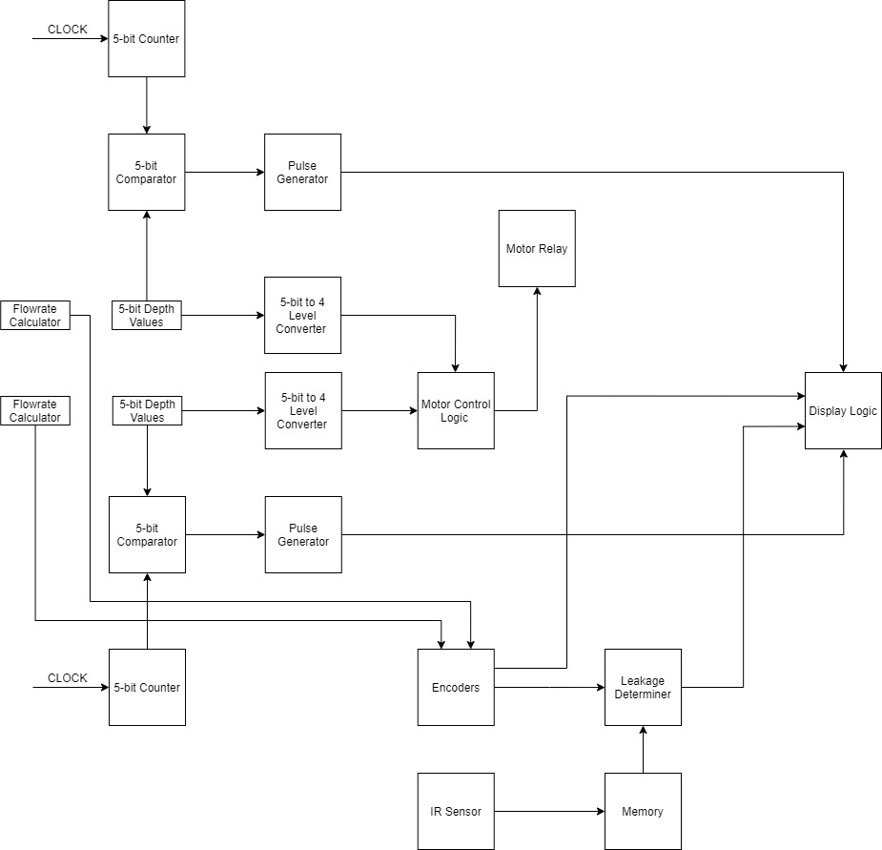
Block Diagram

Slide 16
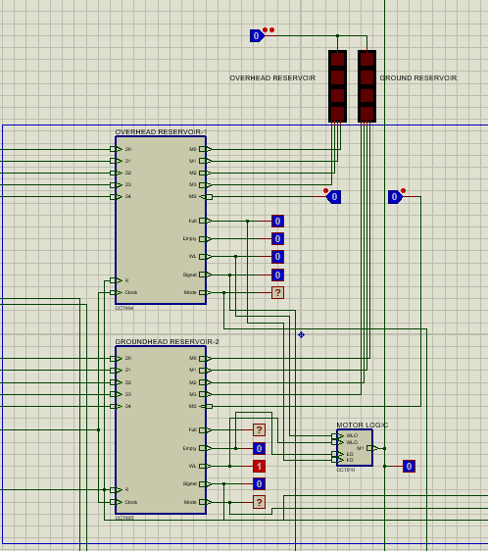
Simulation

Slide 17
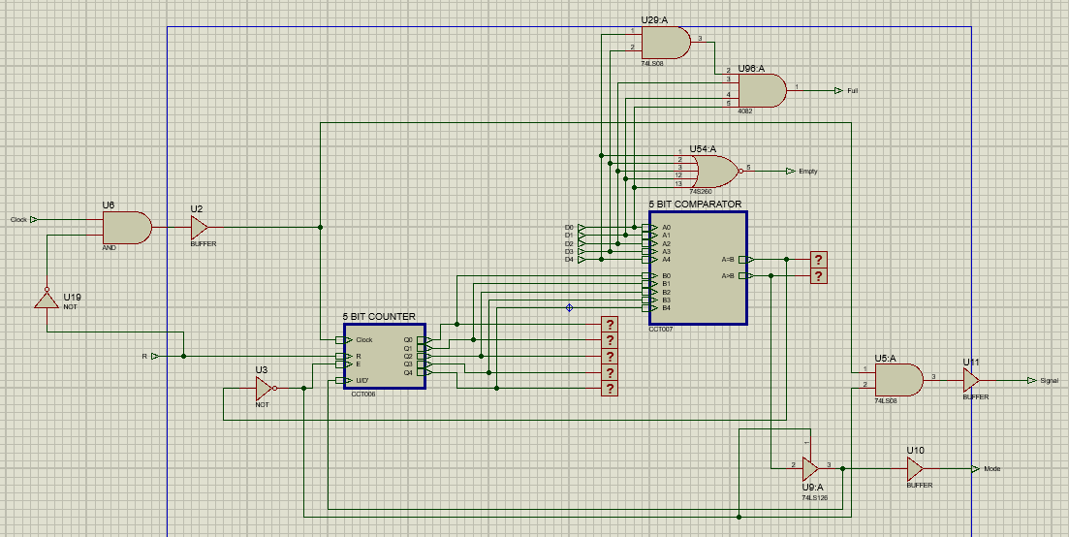
Simulation

Slide 18
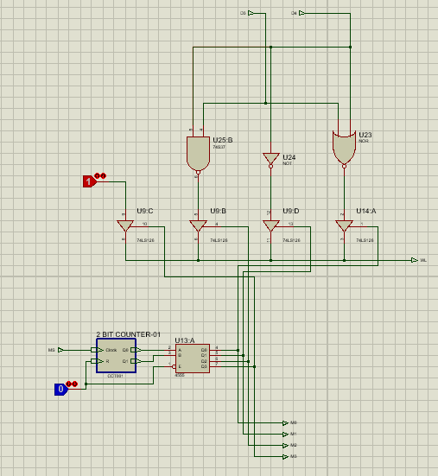
Overhead Reservoir
Simulation

Slide 19
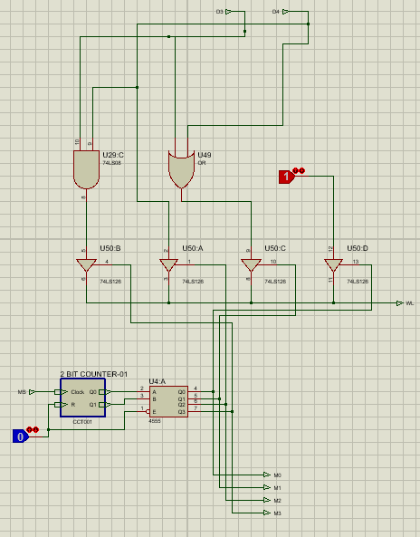
Ground Reservoir
Simulation

Slide 20
Display System
The function of Display Unit is to take input in form of pulses and convert them into Level values by turning On LEDs in form of LED Bar Graphs
It also has logic designed to control buzzers which act as an Alarm System
The RGB LEDs act as indicators for Flowrate of Water

Slide 21
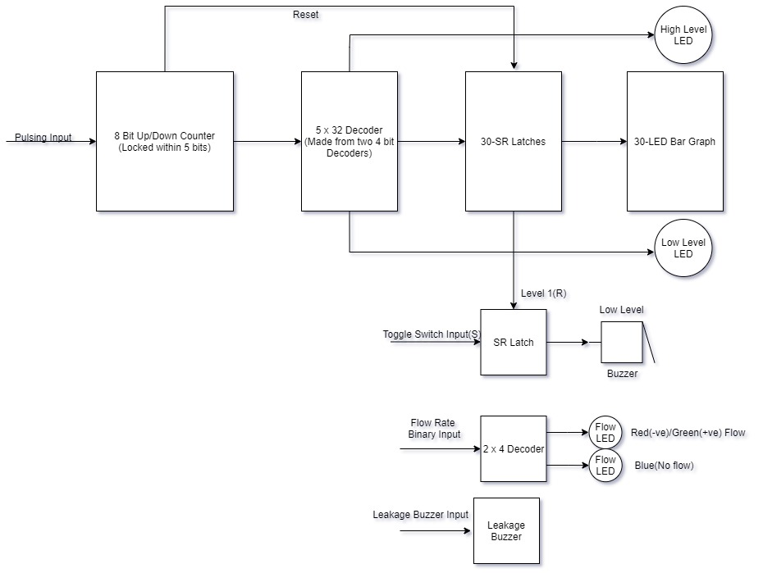
Block Diagram

Slide 22
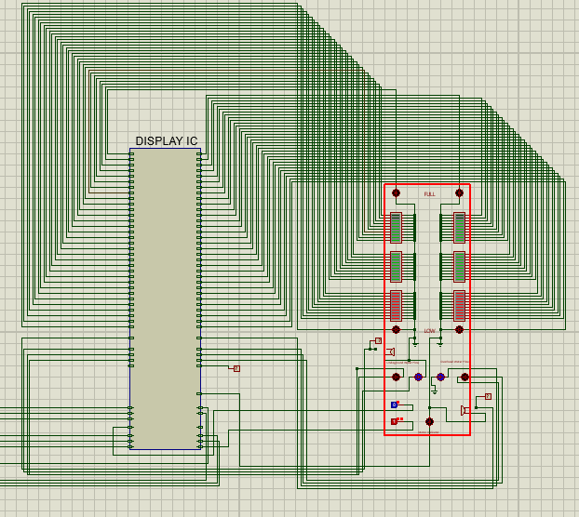
Simulation

Slide 23


Problems Faced
Missing Simulation Models or No Model for 5-bit ICs
Time Lag between Modules due to Simulation not running in real time

Slide 24

Future Prospects
New Logic Design to transfer information from Control Unit to Display Unit
Adjustment Feature for Ultrasonic Sensor Depth Calculator which allows System to be adjusted for various Water Reservoirs with different heights
Sensors for Water Faucets and valves outside Washrooms and Kitchens

Slide 25
Thank You
Question Session

